Slide 1
Music signal processing
COMP.SGN.120
Introduction to Audio processing
Lecture 12

Slide 2
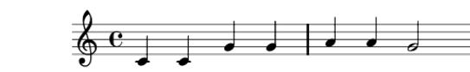
Music
Music is one of the richest and most carefully constructed audio signals.
Music has several overlapping and simultaneously active sources.
Prominent structures are organized in both time and frequency.
Music waveform carries more information than most other signals
In this course, we don’t assume prior knowledge of music.
Basic concepts required by the automatic processing methods are explained.

Slide 3
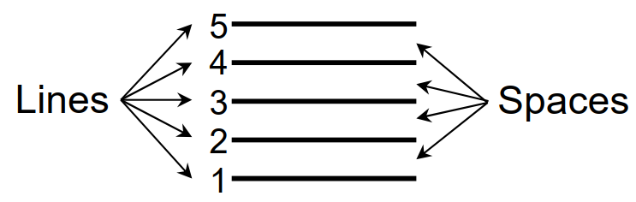
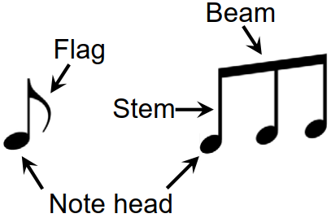
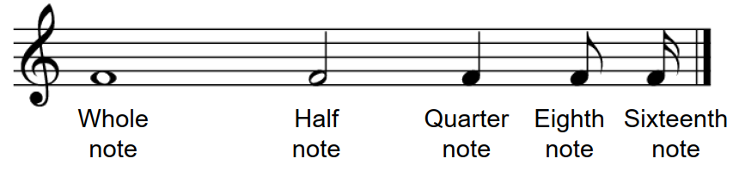
Music representation
Music has its own written notation (musical score)
Describes musical work with formal language based of musical symbols and letters
Musician can create a performance by following such instructions
Similar to different languages, one needs to study this language to master it.
Sheet music representation
Visual description of a musical score.
Image format.
Guide for performing music.
Staff
Parts of a note
Duration of the notes

Slide 4
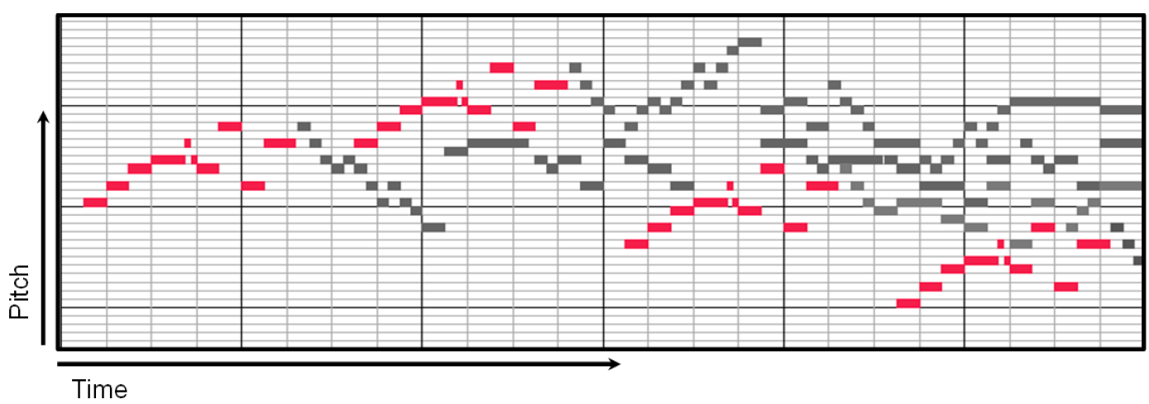
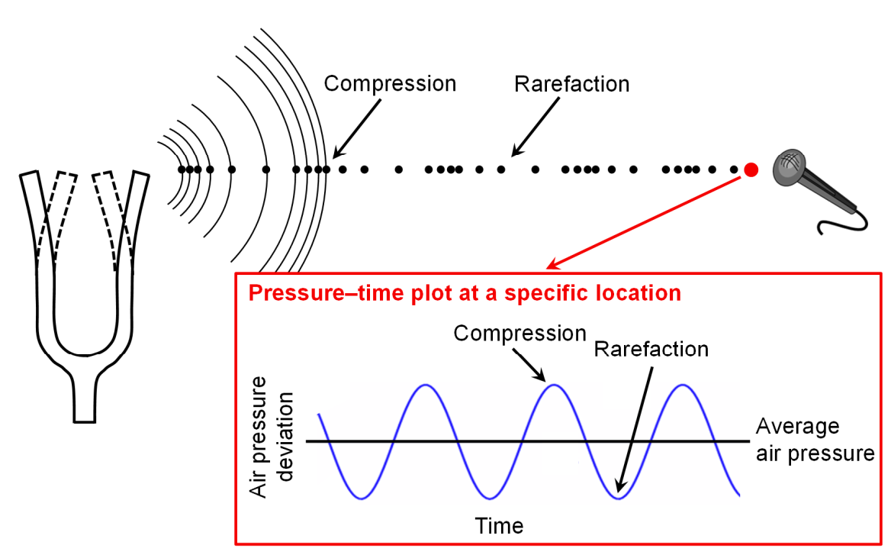
Music representation
Piano roll
Symbolic representations
Description based on entities with explicit musical meaning.
Given in digital format that can be parsed by a computer.
MIDI (Musical Instrument Digital Interface) representation.
Audio representation
Physical description
Encoding of sound wave

Slide 5
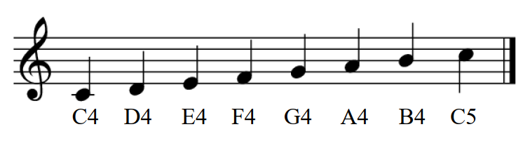
Musical score or Sheet music
Instruments such as the violin, or a singer, can produce notes with arbitrary pitch values
These are quantized into notes
By reading the sheet music, a musician can create a performance:
Figure: staff (5 lines, 4 spaces) denote pitch
Pitch raises upwards
Time goes from left to right
The clef at the start of the staff indicates the position of a particular note on the staff.
Perceptual property that allows a listener to order a sound on a frequency related scale.
- Musical symbol (score representation)
- Pitched sound (audio representation)

Slide 6
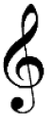
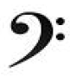
Western music notation
The standard Western music notation is based on a staff.
Generally, it begins with a clef symbol, which indicates the position of one particular note on the staff.
Treble clef or G-clef
Bass clef or F-clef
Also timing of notes is quantized. (Whole note, quarter note, one-eigth, etc.)
Denoted with different shapes of note symbols (or additional symbols)
The overall tempo and style of the piece can be specified by textual notations
Allegro con brio (fast with vigor and spirit)
Andante con moto (moderate tempo with motion)

Slide 7
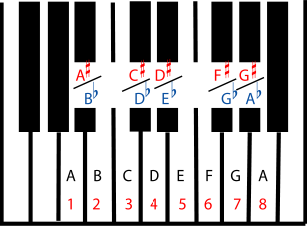
Music scales
Pentatonic (5 notes)
Major and minor diatonic (7 notes)
Chromatic (12 notes)
The white keys are the natural notes
Black keys are named using sharps or flats

Slide 8
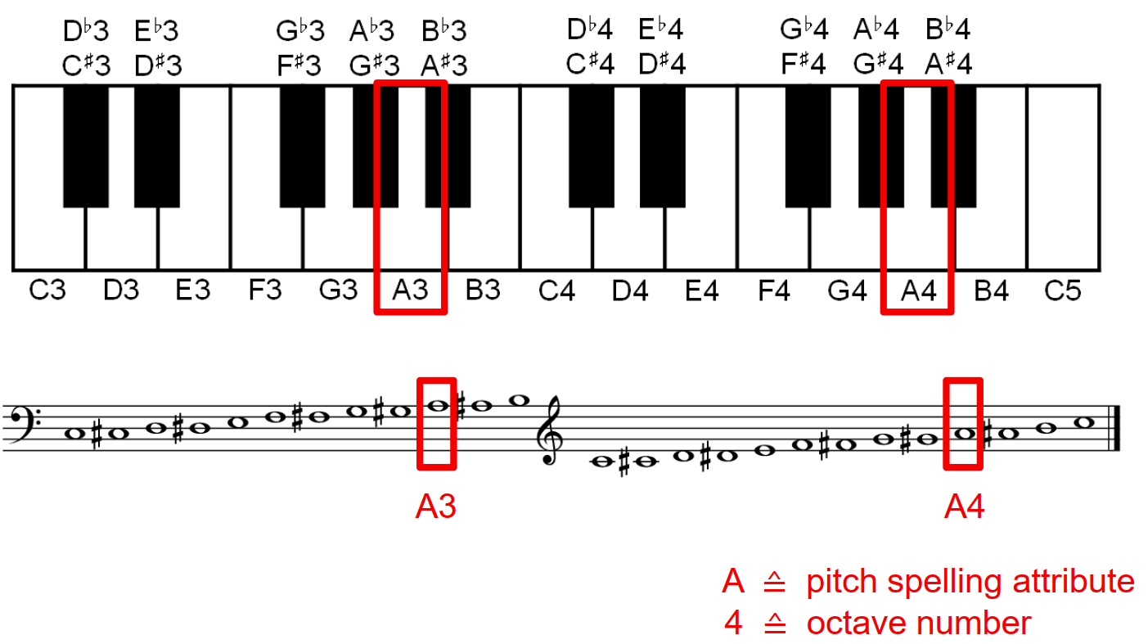

Music terms
Western music uses log-scale with 12 notes in each octave range
Notes are one semitone apart
Called twelve-tone equal-tempered scale
Nominal F0 of note n is 440*2^{(n/12)} (Hz)
440 Hz is an agreed anchor point
Index n varies from -48 to 39 on a standard piano keyboard
Notes in each octave are lettered:
C,C#,D,D#,E,F,G,G#,A,A#,B
The pound symbol (#), read as “sharp”, increases pitch of a note by one semitone
The octave range is indicated with a number following the letter.
By convention: A4 = 440 Hz
E.g. A4# = 466.16 Hz, A5#=932,3 Hz
https://pages.mtu.edu/~suits/notefreqs.html
Piano
violin

Slide 9
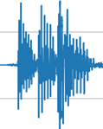
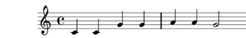
Music terms
Inter-onset interval (IOI)
Time interval between beginning of two sounds
Defines the rhythmic characteristic of a melody
Although duration plays a role too, the lOIs are more crucial in determining the perceived rhythm
Rhythmically important instruments (e.g. drums) produce exponentially decaying waveshapes without a unique definition of duration.
Melody
Series of pitched sounds with musically meaningful pitch and IOI relationships
e.g. sequence of written notes
Chord
A combination of three or more simultaneous notes

Slide 10
Constant Q transform

Slide 11
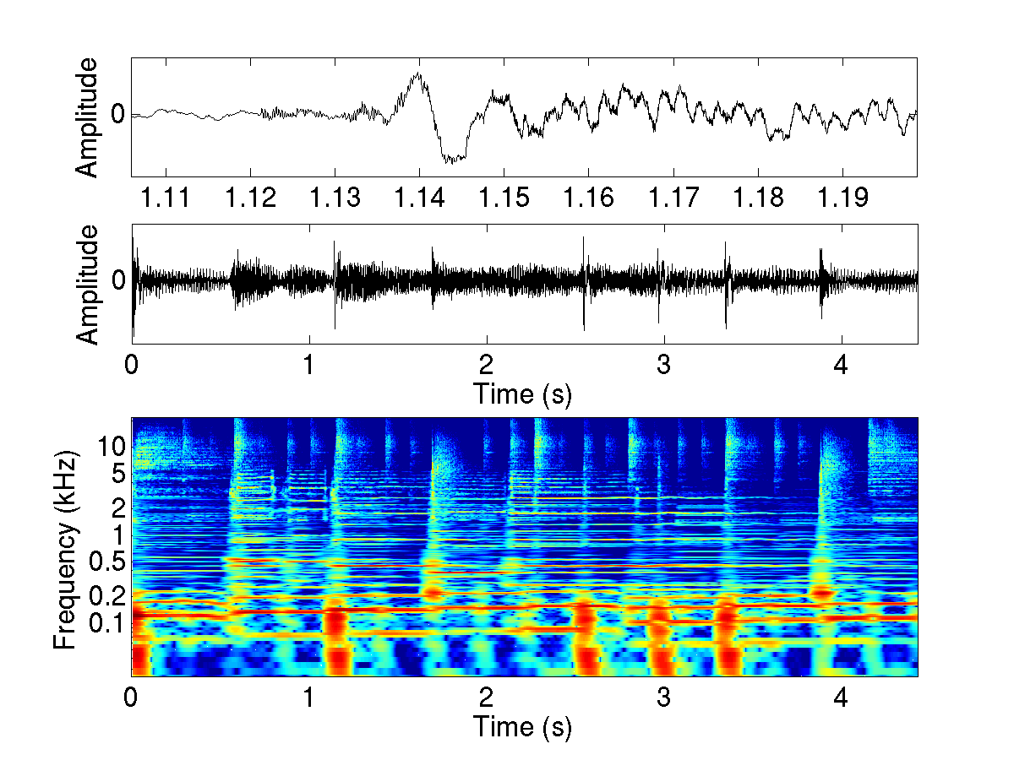
STFT Spectrogram re-cap
Spectrum estimated in short consecutive frames
Windowing to avoid spectral blurring
Transient-like sounds are difficult to represent and process in the frequency domain
Results in time blurring
Notes:
brent .wav

Slide 12
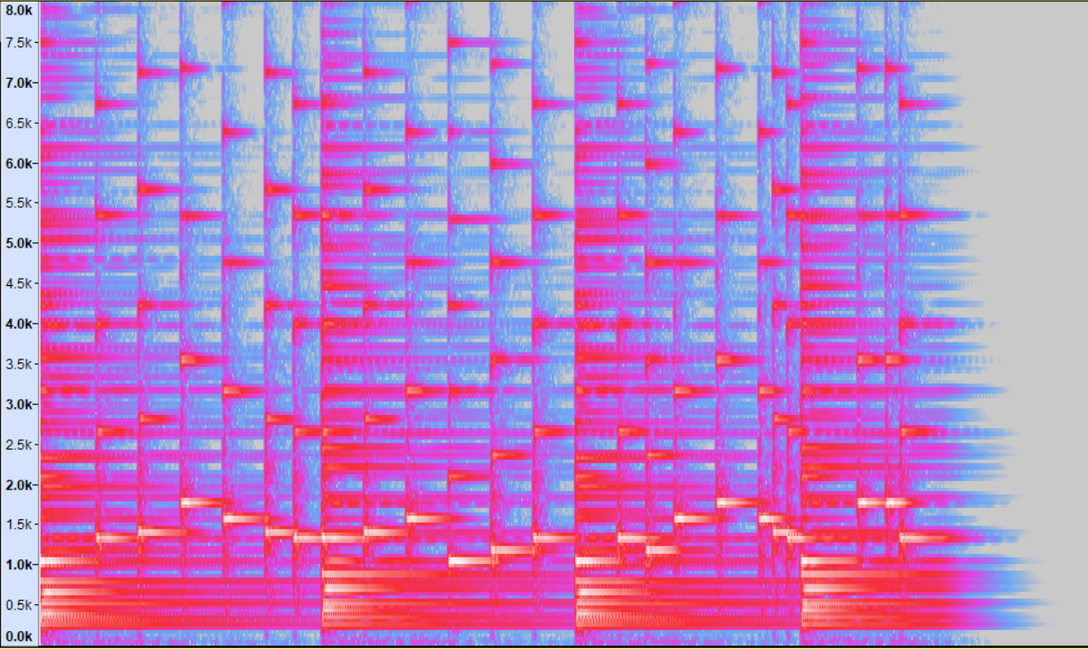
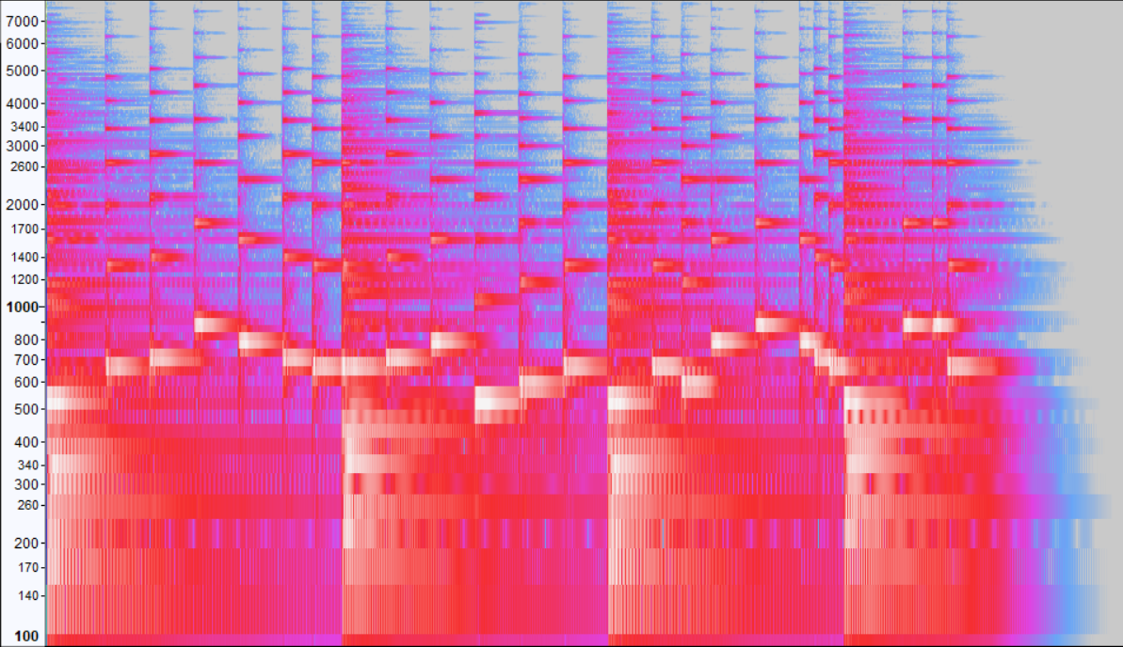
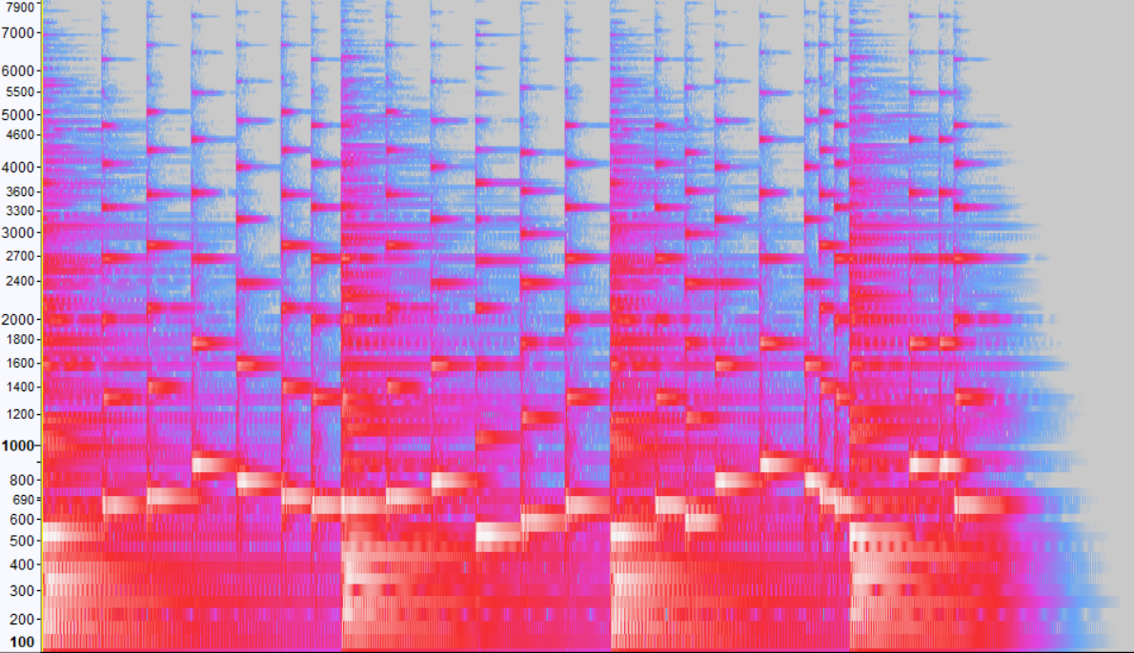
Spectrogram as music notation
Spectrograms look like sort of musical notation. However, the low frequencies are squish together at the bottom, while far a part at the top.
Music notation is in logarithm scale
Linear scale
Logarithmic scale
Mel scale
We want more accuracy at the lower frequencies and less accuracy in the highest frequencies

Slide 13
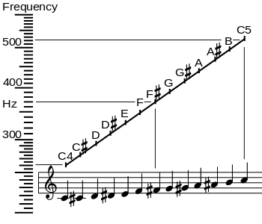
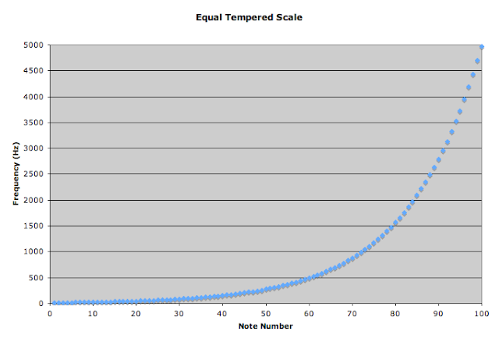
Constant Q transform
Related to Fourier transform.
Time-frequency representation where the frequency bins are uniformly distributed in log-frequency and their Q-factors (ratios of center frequencies to bandwidths) are all equal
This transform is very well suited for musical data, because the output is effectively amplitude against log frequency, so it needs less bins to cover a given range.
It also mirrors the human auditory system where at lower frequencies the resolution is better.

Slide 14
Constant Q transform
Initially proposed in the late 1970s.
Modifies the STFT such that the frequency bins are logarithmically spaced.
The windowing function is adjusted with center frequency so that the width of each bin increases in proportion to the center frequency.
The ratio of frequency-to-bandwidth is kept constant, hence the term “Constant-Q”.
Computationally complex and difficult to implement technique in a real-time music context.

Slide 15
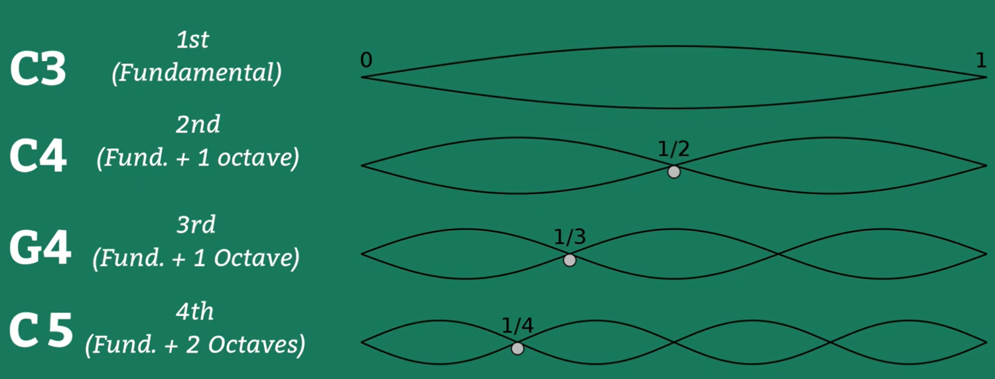
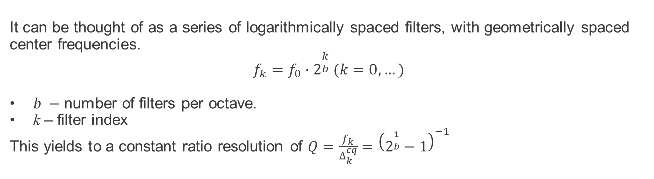
Constant Q transform
It can be thought of as a series of logarithmically spaced filters, with geometrically spaced center frequencies.
$$f_{k}=f_{0}∙2^{\frac{k}{b}} (k=0, …)$$
$b −$number of filters per octave.
k – filter index
This yields to a constant ratio resolution of $Q=\frac{f_{k}}{∆_{k}^{cq}}={\left(2^{\frac{1}{b}}−1\right)}^{−1}$
Octave is a musical interval.
Distance between one note and the next note bearing its same name.
Distance between one note and another note that is double its frequency.
A4 (440Hz) and A5 (880Hz)

Slide 16
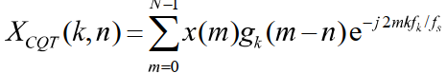
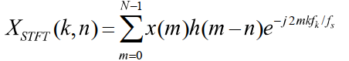
Constant Q transform
Mathematical definition:
where N is length of input signal, g_{k}(m) is zero-centered window function that picks one time frame of the signal at point n and f_{s} sample rate
Compare CQT with short-time Fourier transform (STFT):
where now the window function h(m) is the same for all frequency bins
In CQT, the center frequencies are geometrically spaced: f_{k}=f₀2^{k/B} where B determines the number of bins per octave and f₀ is lowest bin
In DFT, the center frequencies are linearly spaced: f_{k} =kf_{resolution}

Slide 17
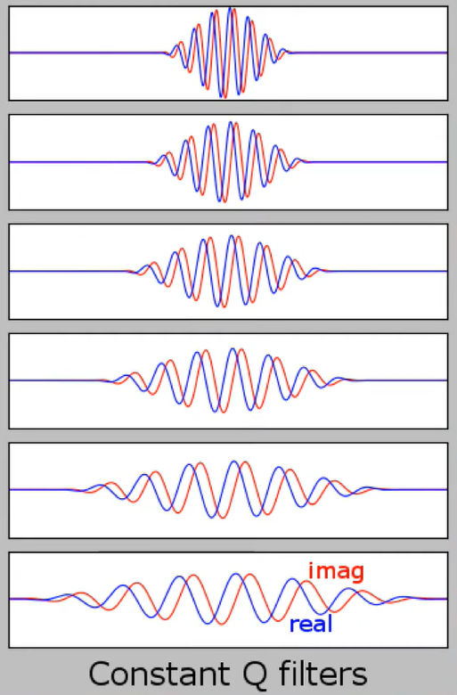
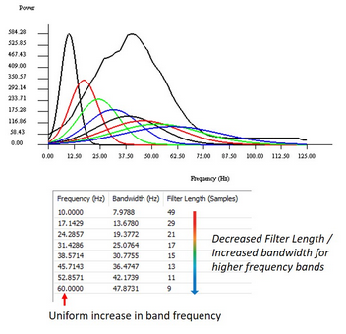
Constant Q filters
The constant Q Transform compared to FFT is quite similar, except that the window function in FFT is the same for all frequency bins, while in CQT we have different windows
The center frequencies for the bins are spaced geometrically for the CQT, and linearly for the DFT.
The higher the frequency the larger the bandwidth of the filter, they accept more variance in the frequency that has been given as input.

Slide 18
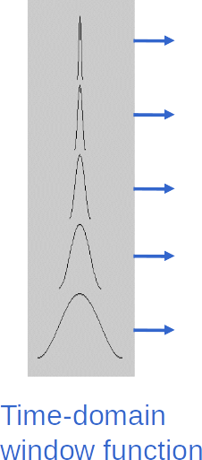
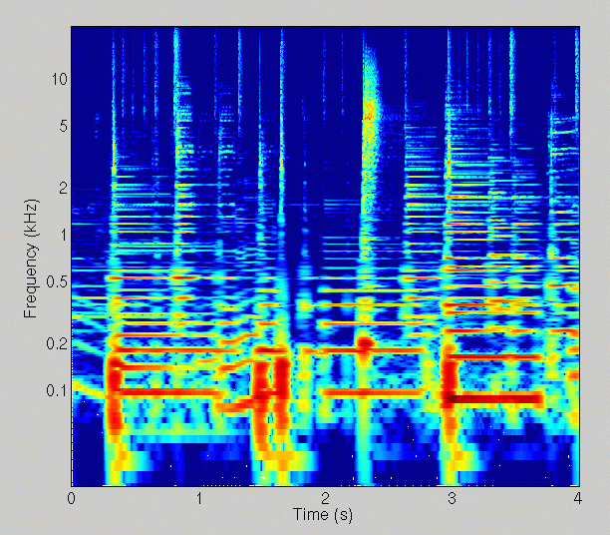
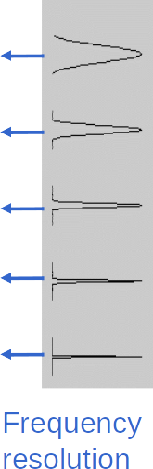
Constant Q transform illustrated
Time-frequency resolution ofered by the constant Q transform.
Long window in time for the lower frequencies and obtain a good frequency resolution, and viceversa.
At higher frequencies we have worse frequency resolution but very good temporal one.
Y-axis is log-frequency, therefore the bandwidths are actually EQUAL on log-scale

Slide 19
Computing CQT
Efficient computation achieved by:
1. FFT of the entire input signal
2. Apply one CQT frequency-bin wide bandpass on the (huge) spectrum
3. Move subband around zero
4. Inverse-FFT transform the narrowband spectrum to get CQT coefficients over time for that bin
Schörkhuber, C., Klapuri, N. Holighaus, and M. Döfler, "A Matlab Toolbox for Efficient Perfect Reconstruction Time-Frequency Transforms with Log-Frequency Resolution," AES 53rd International Conference on Semantic Audio, London, UK, 2014.
https://www.cs.tut.fi/sgn/arg/CQT/
librosa.core.cqt

Slide 20
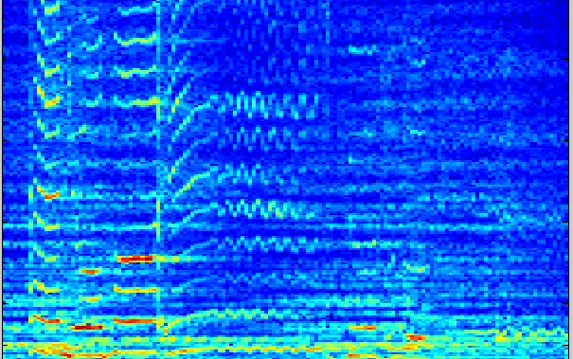
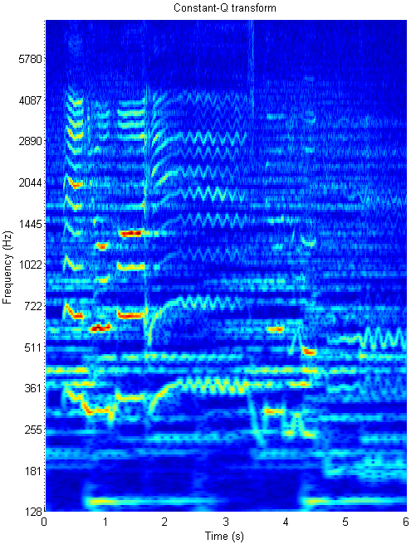
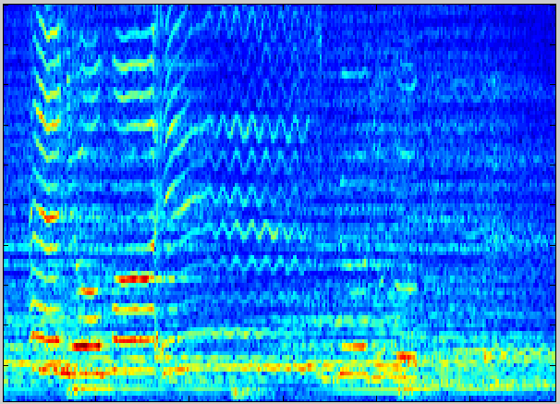
CQT vs STFT
STFT, search of a trade off.
So here we have good resolution for the low frequencies (upper panel)
While in the panel below we have better resolution for the higher ones.

Slide 21
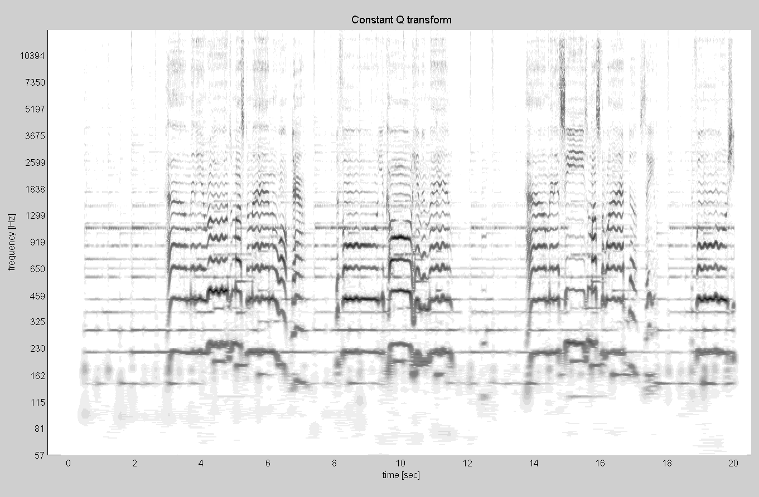
Another example of constant Q transform representation

Slide 22
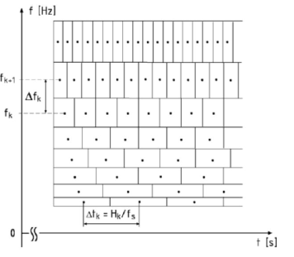
Drawbacks of CQT
CQT is computationally more intensive than DFT spectrogram
CQT produces a data structure that is more difficult to handle than the time-frequency matrix (spectrogram)
The spectrogram is simply a time-frequency matrix, while in CQT we need to handle coefficients that represent different lengths.
This is because in CQT the time resolution varies for different frequency bins, in effect meaning that the “sampling” of different frequency bins is not synchronized.

Slide 23
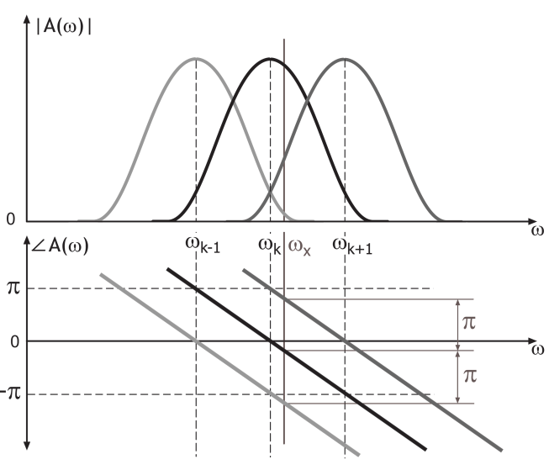
Example application: Pitch shifting
Pitch shifting is a natural operation in CQT domain:
1. CQT
2. Shift CQT coefficients
3. Retain phase coherence
4. Inverse CQT
Examples:
Original
- 6 semitones
+6 semitones
Transients at high freqs. are retained due to short frame
phase coherence is lost when CQT coefficients are shifted along the frequency dimension.
Neighboring bins excited by the
same sinusoid share the same phase value
Notes:
Orig, p6 m6 3 examples

Slide 24
Chroma

Slide 25
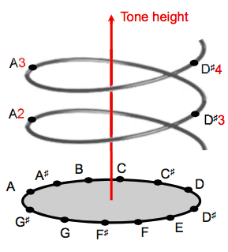
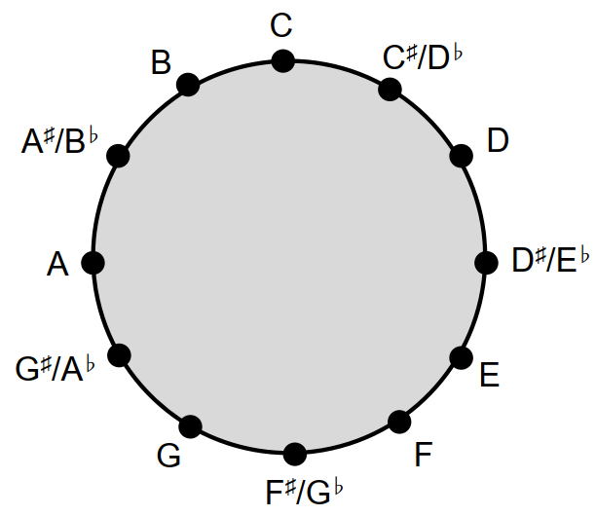
Chromatic scale
(From slide 8)
Music scales:
Chromatic (12 notes)
The term chromatic is derived from the Greek word chroma, meaning color.
In music domain it relates to the twelve different pitch classes.
Notes C2 and C5 both have the same chroma value C.
All notes that have the same chroma value belong to the same pitch class.
m
Chroma representation gives a description of the different notes present in the audio without distinguishing the octave in which they occur.
Shepard’s helix of pitch, represents the linear pitch space as a helix wrapped around a cylinder. The octave-related pitches lie along a vertical line.
Chromatic circle

Slide 26
Chromagram
The main idea of chroma features is to aggregate all spectral information that relates to a given pitch class into a single coefficient
Basic algorithm using FFT
for each fft_bin do
chroma_bin = mod(round(12*log2(freq(fft_bin)/freq(C4)) ),12)
chroma_energy[chroma_bin] += fft_energy[fft_bin]
end for
freq(fft_bin): returns the frequency of fft_bin in Hz.
freq(C4): 261.5 Hz
chroma_energy is normalized to retain only pitch info and remove signal level information
The frequency resolution of lower bins and non-tonal energy cause issues, which refined algorithms mitigate
C4 12*log2(261.5/261.5)=0
C#4/Db4 12*log2(277.18/261.5)=1
D4 12*log2(293.66/261.5)=2

Slide 27
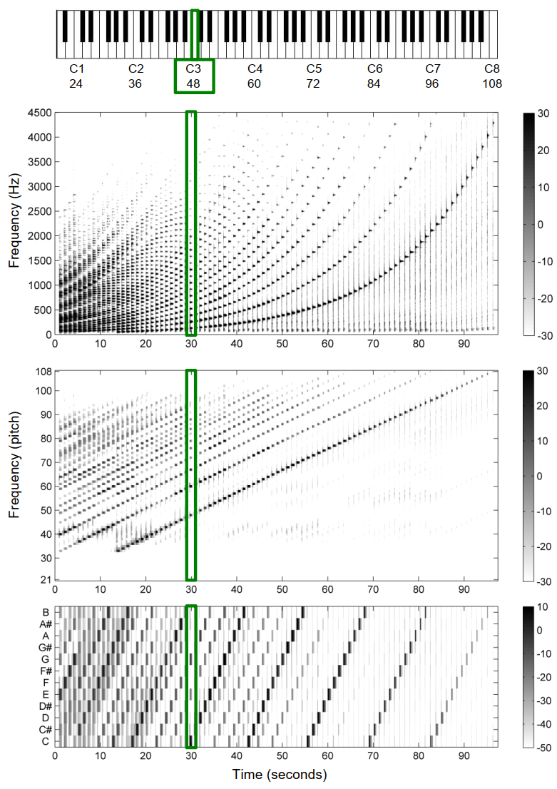
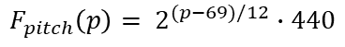
Piano keys representing the chromatic scale
Note C3 (p=48) played at time 30 seconds
(MIDI note number)
$$F_{pitch}\left(p\right)= 2^{(p−69)/12}∙440$$
Magnitude spectrogram
Pitch-based log-frequency spectrogram
Chromagram

Slide 28
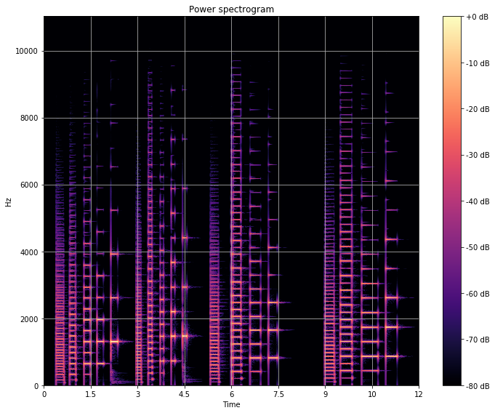
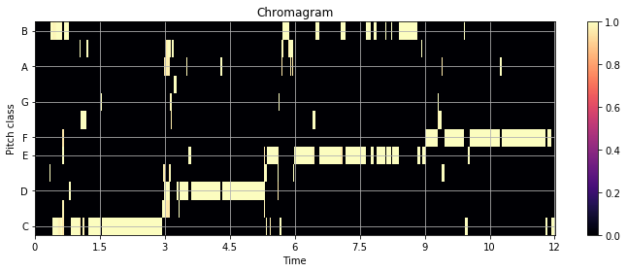
Example: Piano notes in different octaves
Notes C0-C3, D0-D3,E0-E3,F0-F3 are played in a sequence
Top figure: power spectrogram of the signal.
Note the octave raise.
Chromagram shows the same pitch class value for the different octave notes
Bottom figure evaluated from data using Python/librosa.
Notes:
piano

Slide 29
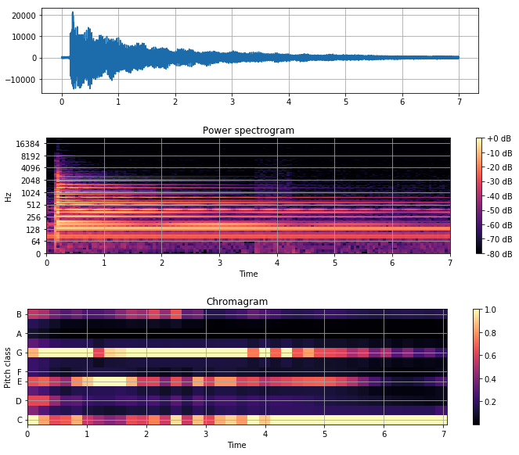
Example: Chromagram of a chord
C-major (G,E,C), visible in chromagram
Notes:
c-major-chord.wav

Slide 30
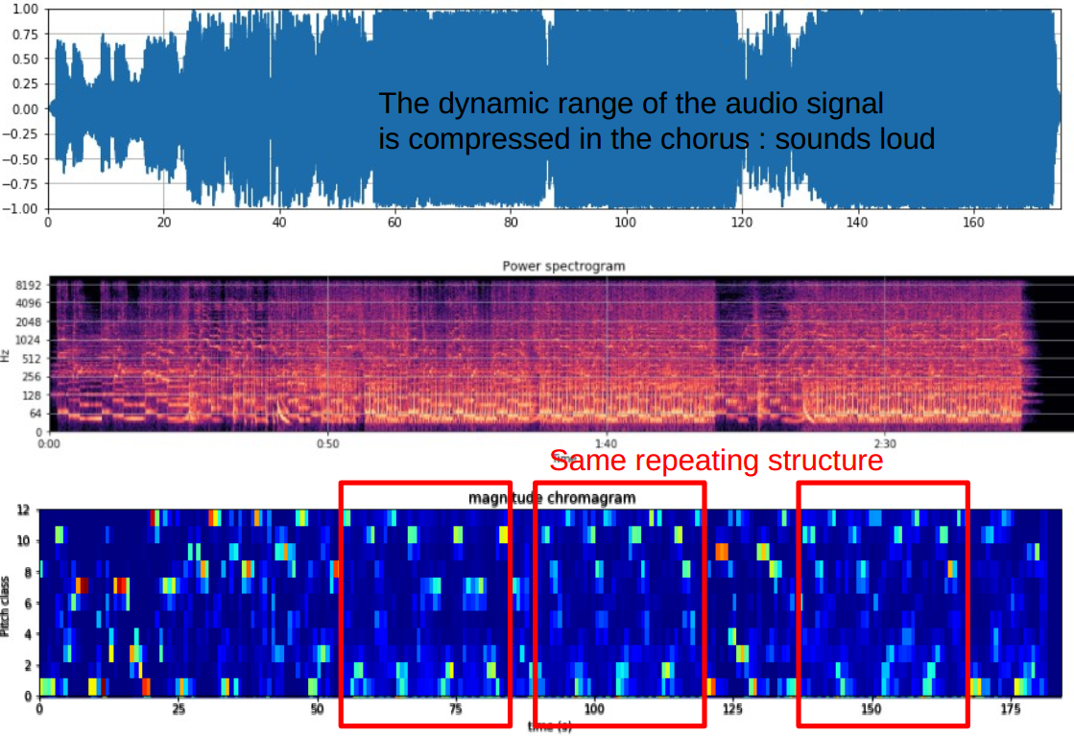
Example: Finnish Eurovision 2018 candidate song Monsters by Saara Aalto

Slide 31
Dynamic Time Warping
Music synchronization

Slide 32
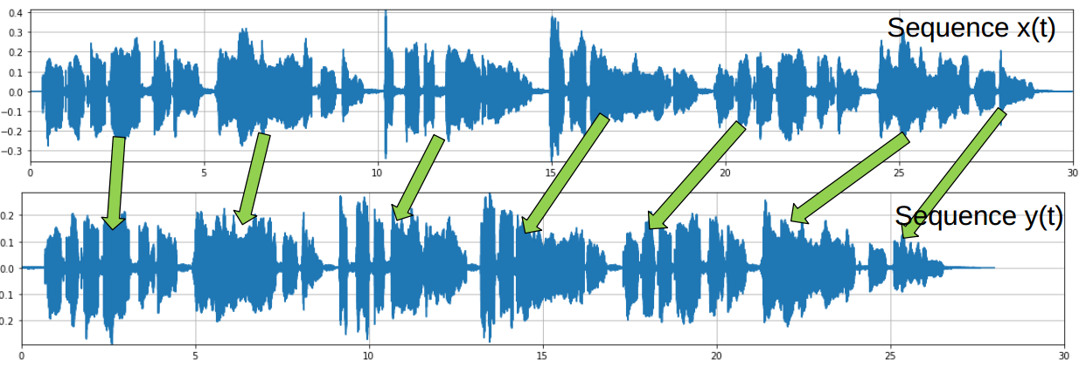
Music synchronization
Synchronization here refers to a procedure to determine the corresponding position in a piece of music, given another (slightly differently interpreted) piece of music
Figure: Two different tempo performances of a same song

Slide 33
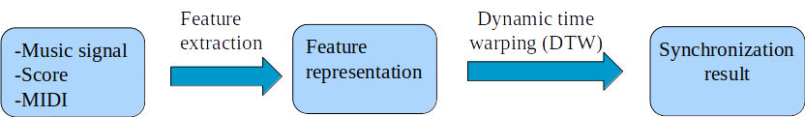
Music synchronization
Procedure for music synchronization
Uses
Allows synchronization of score of music with audio track
Jump to audio position, based on selected score position
Seamless switching between different versions of same music
Measure differences in tempo between same musical piece versions
To analyze the performance

Slide 34
Music synchronization
Need right types of features that
Retain relevant information, while suppressing irrelevant details
Capture similarity between notes and chords
Allow variation between instrumentation (timbre), tempo, rhythm
Suitable features include chroma vectors
Dynamic time warping (DTW)
Used to align the two feature representation sequences (of feature vectors) of two different versions of the same piece of music
DTW Goal: find an optimal alignment between two sequences
DTW is used in data mining, information retrieval, and bioinformatics

Slide 35
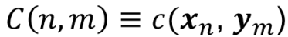
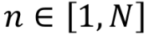
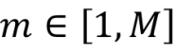
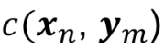
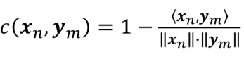
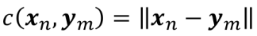
Dynamic time warping
Input: two sequences 𝑿= [𝒙₁, .. 𝒙_{N}] and 𝙔=[𝒚₁,..., 𝒚_{M}]
Define a real-valued cost matrix
is a cost function:
Cosine distance
Euclidean distance
Generally: if 𝒙_{n} is similar to 𝒚_{n} then the cost should be low
A warping path P = (𝒑₁, .. 𝒑_{L}) of length L,
𝒑_{l}=(n_{l}, m_{l}) denotes correspondence between the two sequences
Starts from 𝒑₁=(1,1) and ends in 𝒑₁=(N,M)
Steps are monotonically increasing (no going back in time)

Slide 36
Example
X=[1,1,0,2,2], N=5, and Y=[1,0,2], M=3
Cost function c(n,m)=|x_{n}-y_{m}|, i.e. absolute distance (L1)
Optimal path
P* = {(3,5),(3,4),(2,3),(1,2),(1,1)}, L=5
Cost of path: (sum the optimal path cell values (blue)) = 0
2 | 1 | 2 | 0
2 | 1 | 2 | 0
0 | 1 | 0 | 2
1 | 0 | 1 | 1
1 | 0 | 1 | 1
 | 1 | 0 | 2
2 | 3 | 4 | 0
2 | 2 | 2 | 0
0 | 1 | 0 | 2
1 | 0 | 1 | 2
1 | 0 | 1 | 2
 | 1 | 0 | 2
Original cost + min(steps) of already computed values.
1 + min(1,1,2) = 1 + 1 = 2
Cost matrix
Accumulated cost matrix

Slide 37



Example: Music synchronization
A song is sung twice, upper one is 7% faster
Bottom figure: Chroma features (using librosa)

Slide 38

Cost matrix and optimal path
Distance: Euclidean distance between chromagram vectors at each time instant
Red-lines: Two synchronized notes
Yellow line: Linear time
White line: Optimal path
Optimal path shows the corresponding time instant for both songs.

Slide 39

DTW summary
Gives the synchronization of feature representations of two signals.
Cost functions
Cosine distance: not sensitive to absolute level (since the vectors are normalized by definition)
Euclidean distance: Is sensitive to level differences if features are not normalized.
Feature normalization: by normalizing the feature vector of each time-value, the feature is not sensitive to level anymore.
Tools: DTW available in librosa
Representation of Euclidean distance (d) and cosine similarity (θ)

Slide 40
Tempo, beat

Slide 41

Temporal structure
Music is organized into temporal units, called beats
Rhythm refers to pattern of strong and weak beats
Musical meter refers to the rhythm aspect of music
Most noticeable metrical level is the tactus
Sometimes called “the foot tapping rate” or just “beat”
Beat is the backbone of a piece of music, which makes the automatic detection of beat an important sub-task in music processing.
Duration of a beat is given by tempo, indicated in beats per minute (BPM).

Slide 42

Tempo analysis
Above the level of chords and notes, are phrases and sections
Coherent sequences of chords/notes that often repeat with no or little variation, e.g. in pop songs: intro-verse-chorus-verse-chorus…
The extraction of tempo and beat is challenging, particularly for music with weak note onsets and local tempo changes.
Tatum (temporal atom) level refers to the fastest repetition rate of musically meaningul accents occurring in the signal.

Slide 43
Beat tracking
Beat position approximations:
Often occurs at note onset position
Intervals are approximately constant
Typical onset detection flow
Onset detection: detect note start time
For single notes, simply looking at the signal energy is a start
However, simultaneous occurrence of events makes this approach not so robust, therefore time-frequency domain is more suitable
Often, temporally simultaneous events do not overlap in frequency.
Derivative
Peak picking
Signal
Features
Novelty function
Beat positions

Slide 44

Novelty function: find local changes in signal properties such as energy or spectral content.
Fourier tempogram, time –tempo representations, which captures the local tempo characteristics of music signals
(c)
Correlation of novelty function and various analyzing windowed sinusoids.
(d)
(e)

Slide 45


Beat tracking
Signal
The spectral based novelty function for beat tracking:
Take STFT X(n,k) of signal x(t)
n=time frame, k=frequency index, t=sample time index
Apply log-compression to magnitude spectrum:
where 𝛾 = 1 weak components become visible
𝛾 >> 1: may amplify also noise-like weak components
Calculate the spectral novelty function:
Pick peak locations of ∆(n) and convert STFT time frame index n into seconds.
Features
Derivative
Novelty function
Peak picking
Beat positions

Slide 46



Example: Queen Another one bites the dust
Double bass note (offbeat)

Slide 47

Tempo analysis
Tempo = how many times per minute the beat repeats?
Tempo = 60 / T [BPM],
where T is “beat interval time”, BPM is beats per minute
Tempo is extracted by analyzing the periodic behavior of the novelty function.
Tempo can change during song, so analysis is done in segments of 4-12 s
Practically we can limit tempo between [30,600] BPM
T (beat interval)

Slide 48
Music structure analysis

Slide 49


Structure detection
Self-similarity of temporal segments can be examined using a similarity matrix, with cells representing similarity of two feature vectors 𝒙_{n}, 𝒙_{m} from time instantants n,m
e.g. cosine similarity:
Idea: similar vectors 𝒙_{n}, 𝒙_{m} should lead to high similarity value.
Recurring patterns become visible as large values
Homogeneity results in a block structure (features capture musical sequences that stay somewhat constant over the part)
Two repeating harmonic progressions or melodies highly similar to each other create diagonal lines in the self-similarity matrix.

Slide 50

Structure with self-similarity matrix
Similarity measure: cosine.
Features: chroma.
Each cell is the cosine-distance between the chroma vectors in x,y coordinate time positions of same signal.
Repeated patterns are similar (high cosine similarity) and show as diagonal strips
D & F are most similar:
chorus (song+accompaniment)
C is similar to D and F, visible as elevated value block structure, less diagonal stripes:
It is the chorus without singer
B has diagonal stripes as D and F.
Chorus with singing and only some instruments present)

Slide 51

Similarity matrix computation

Slide 52
Self-similarity matrix
Self-similarity matrix can be used to analyze the structure of a song
Applications
Automatic segmentation
Here the lines between song parts were drawn manually, but this can be automatically done
Audio thumbnailing:
Extracting most representative part of a song
Tools: Music Structure Analysis Framework
https://github.com/urinieto/msaf (contains automatic segmentation)

Slide 53
Content-based music retrieval

Slide 54
Music information retrieval (MIR)
Multidisciplinary science of retrieving information from music
Aims to develop strategies to quickly access music collections through content analysis.
Subtasks of MIR include (but are not limited to):
Beat tracking: Automatic analysis of temporal structure of music (beat, tempo, rhythm, meter)
Chord and key recognition
Melody estimation: Melody is a strong indicator of the identity of a musical piece.
Music fingerprinting (for exact identification of a musical piece)
Genre recognition
Recommendation
Instrument recognition
Score alignment (synchronize audio and score)
Structure analysis (which parts are in the song and in what order, intro, chorus, verse)
….

Slide 55



MIR
Information Retrieval
In the general sense, is the task of organizing information and making it accessible and useful.
Process:
User specifies his/her needs with a query.
Retrieval system deliver items that are related to the query.
Most systems rely on metadata and textual annotations of the audio content.
Metadata describes the content of the musical piece
Can be analyzed by humans (domain experts) or by computers
Factual metadata such as performer, year, name of the song, album.
Cultural metadata includes attributes like mood, emotion, genre, style, etc.. (Referred also as “tags”)

Slide 56

Music recommendation systems

Slide 57
Audio-based music retrieval
Genre (jazz, rock) tempo (slow, fast)
Collaborative filtering (CF) does not solve it all
CF does not allow separating the various dimensions of music similarity, but these are all mixed in the piece profile
CF alone is not able to deal with items that are new or do not have many listeners
Audio-based MIR addresses the above problems
Enables “truly musical queries” with specific musical criteria, such as requesting pieces with certain vocal characteristics or slow tempo → profile of a song
Can be employed even on media libraries that do not have any audience of listeners
On the other hand, audio-based MIR alone cannot measure aspects like quality, usage (popularity), or culture
The two approaches are complementary

Slide 58
Content-based audio retrieval
Content based retrieval make use or the raw music data, rather than rely on manually generated information
Content based music description allows:
Identify what the user is searching, even if the user does not specifically know herself (music similarities)
Identify music captured from loudspeakers in a noisy space (e.g. shazam)
Identify song name based on user’s humming (Query by humming)
Content based retrieval
Retrieval process starts with a query (text, audio)
Retrieval system returns all items that are somehow related to the query

Slide 59
Query mechanisms
Query by example
Given music representation or fragment, retrieve music with similar parts or aspects.
Browse by similarity
Find similar music
Query by humming or tapping
Tempo
Lyrics
Music categories (genre, mood, tags)

Slide 60
Query by humming
Consists of two main steps:
Melody transcription of a hummed or sung query into a suitable higher-level representation
Matching that representation against a large database of known reference items
Example method [Ryynänen, M., & Klapuri, A. (ICASSP 2008)]
Preprocessing: extract melodies automatically from music pieces
Transcribe the query
Match by Euclidean distance between the two melodic contours (allow time scaling)
Query 1
Query 2
Process:
SFTF of the audio
Pitch detection, most dominant pitch tract
MIDI representation (quantize notes)
Encodes in an invariant scaling form
Performed for the whole dataset.
First retrieve
First retrieve
Second retrieve
Second retrieve

Slide 61
Music similarity
Music similarity estimation enables query by example and browsing by artist similarity
Widely used acoustic features
Mel-frequency cepstral coefficients (MFCCs) → timbre/instrumentation
Chroma: collapse spectral content into one octave and use 12 bins for the total spectral energy on each pitch class (c, c#, d,...,b) → harmonic content
Rhythmogram (or, fluctuation patterns): cosine transform in blocks that extend in time direction → rhythm

Slide 62
Features define “similarity”
“Similarity” as such is not well-defined
Is Bohemian Rhapsody by Queen
more similar to … ?
Bohemian Rhapsody by London Symphony Orchestra
Killer Queen by Queen
The riddle is solved by choosing the acoustic features
chroma a) is more similar (composition)
MFCCs b) is more similar (instrumentation)
User may wish to specify the features when doing query by example

Slide 63

Music classification
Music can be classified according to higher level tags of the song, such as style, genre, mood, etc.
Classical train/test supervised classification scenario:
MIREX: Classify music into categories
genre: rock, hip hop, jazz, classical,...
mood: aggressive, passionate, humorous, cheerful,..
artist identification
classical composer identification

Slide 64
References
Müller, ” Fundamentals of Music Processing”, Springer 2015
Klapuri, Davy, “Signal processing methods for music transcription”, Springer 2006
Judith C. Brown; Calculation of a constant Q spectral transform. J. Acoust. Soc. Am. 1 January 1991; 89 (1): 425–434. https://doi.org/10.1121/1.400476

